Slide 1

Notes:
NOTE: LEAVE THIS SLIDE AS-IS NOTE: `scoped` is used to limit the styles to the current slide Title Socials Logos

Slide 2

Notes:
NOTE: A `_` prefix is used to change properties for only the current slide NOTE: Multiple images added here - one in BG, one in FG

Slide 3
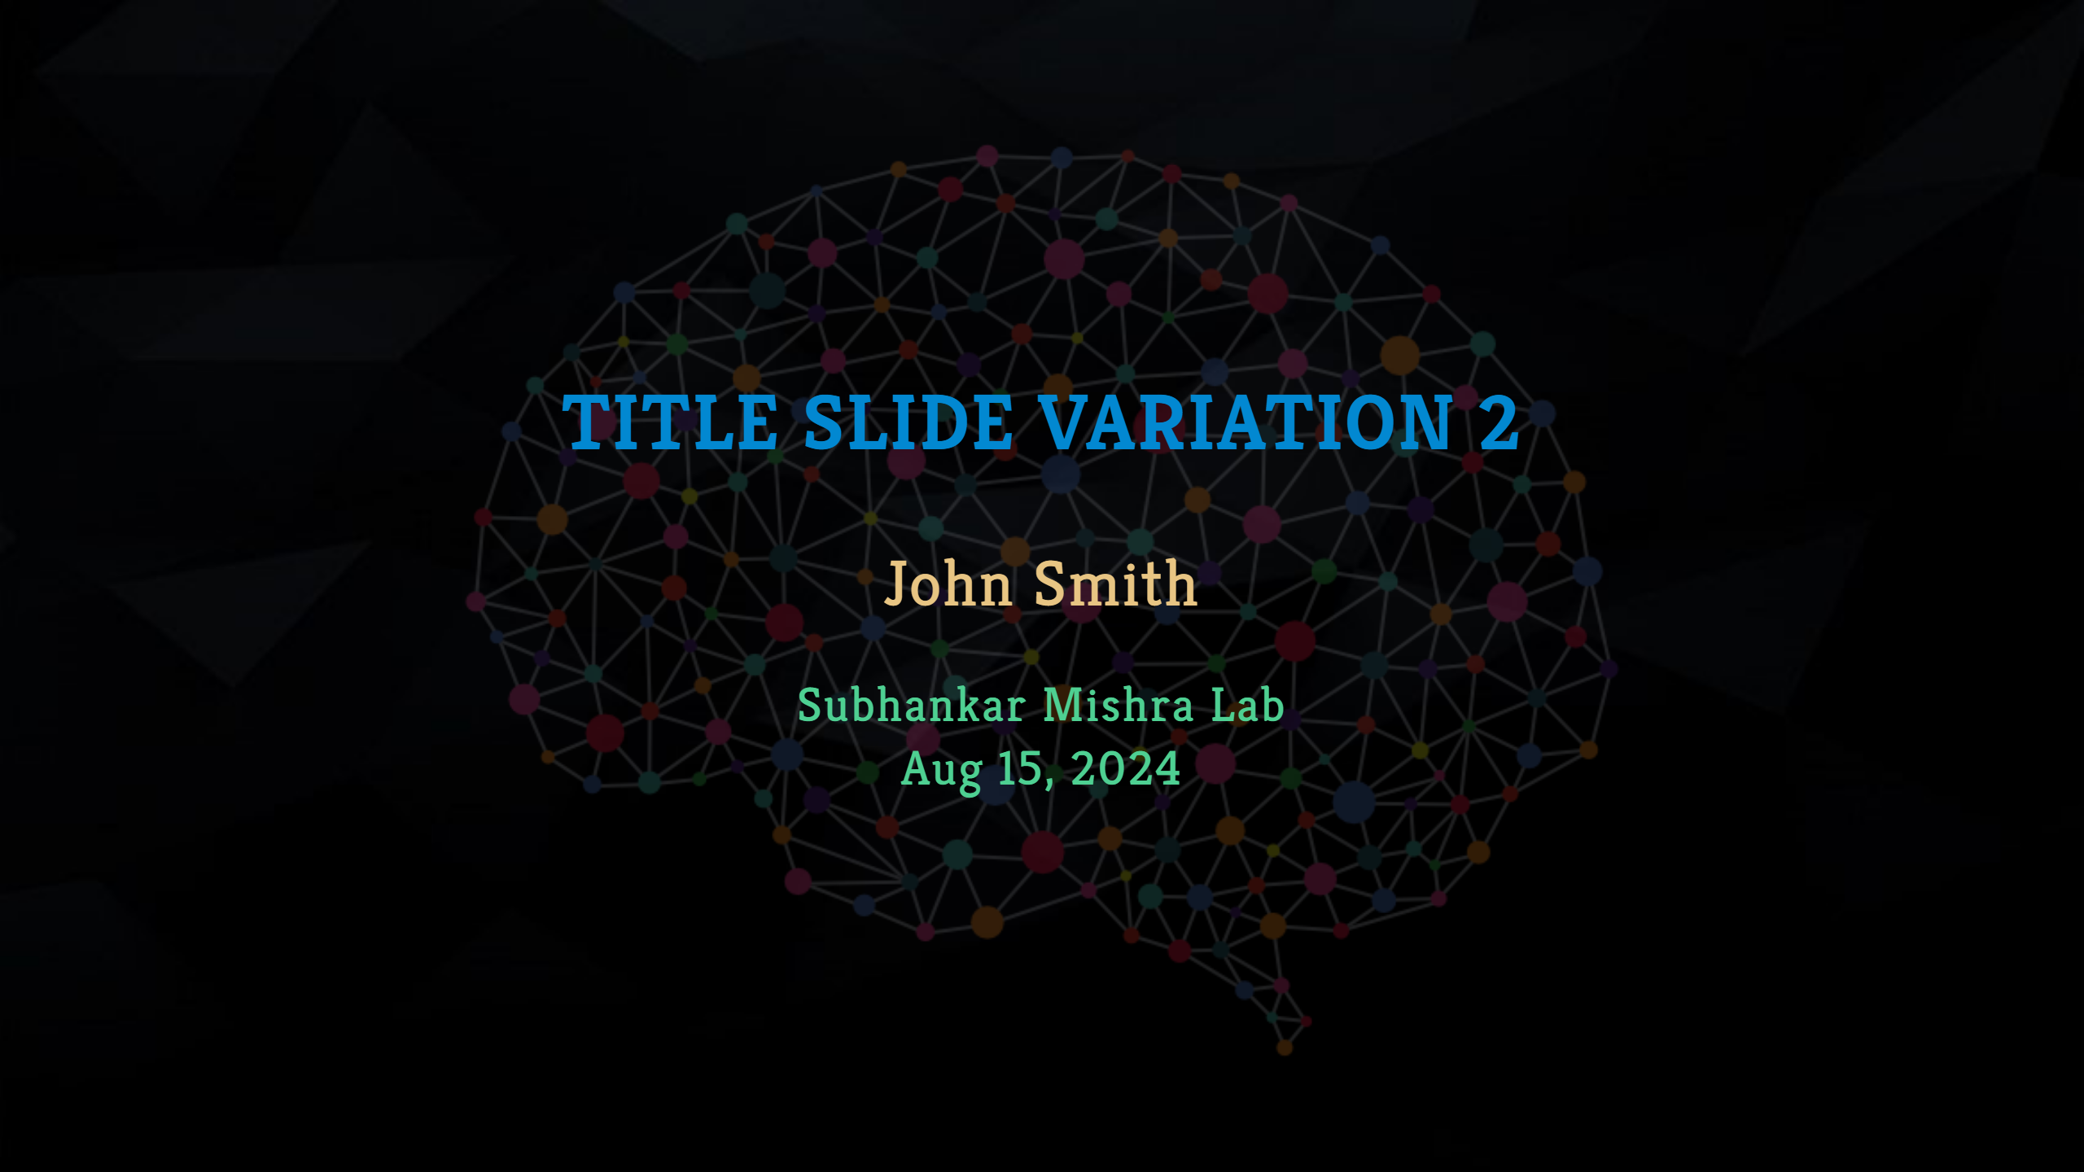
Notes:
NOTE: Another example of title slide

Slide 4
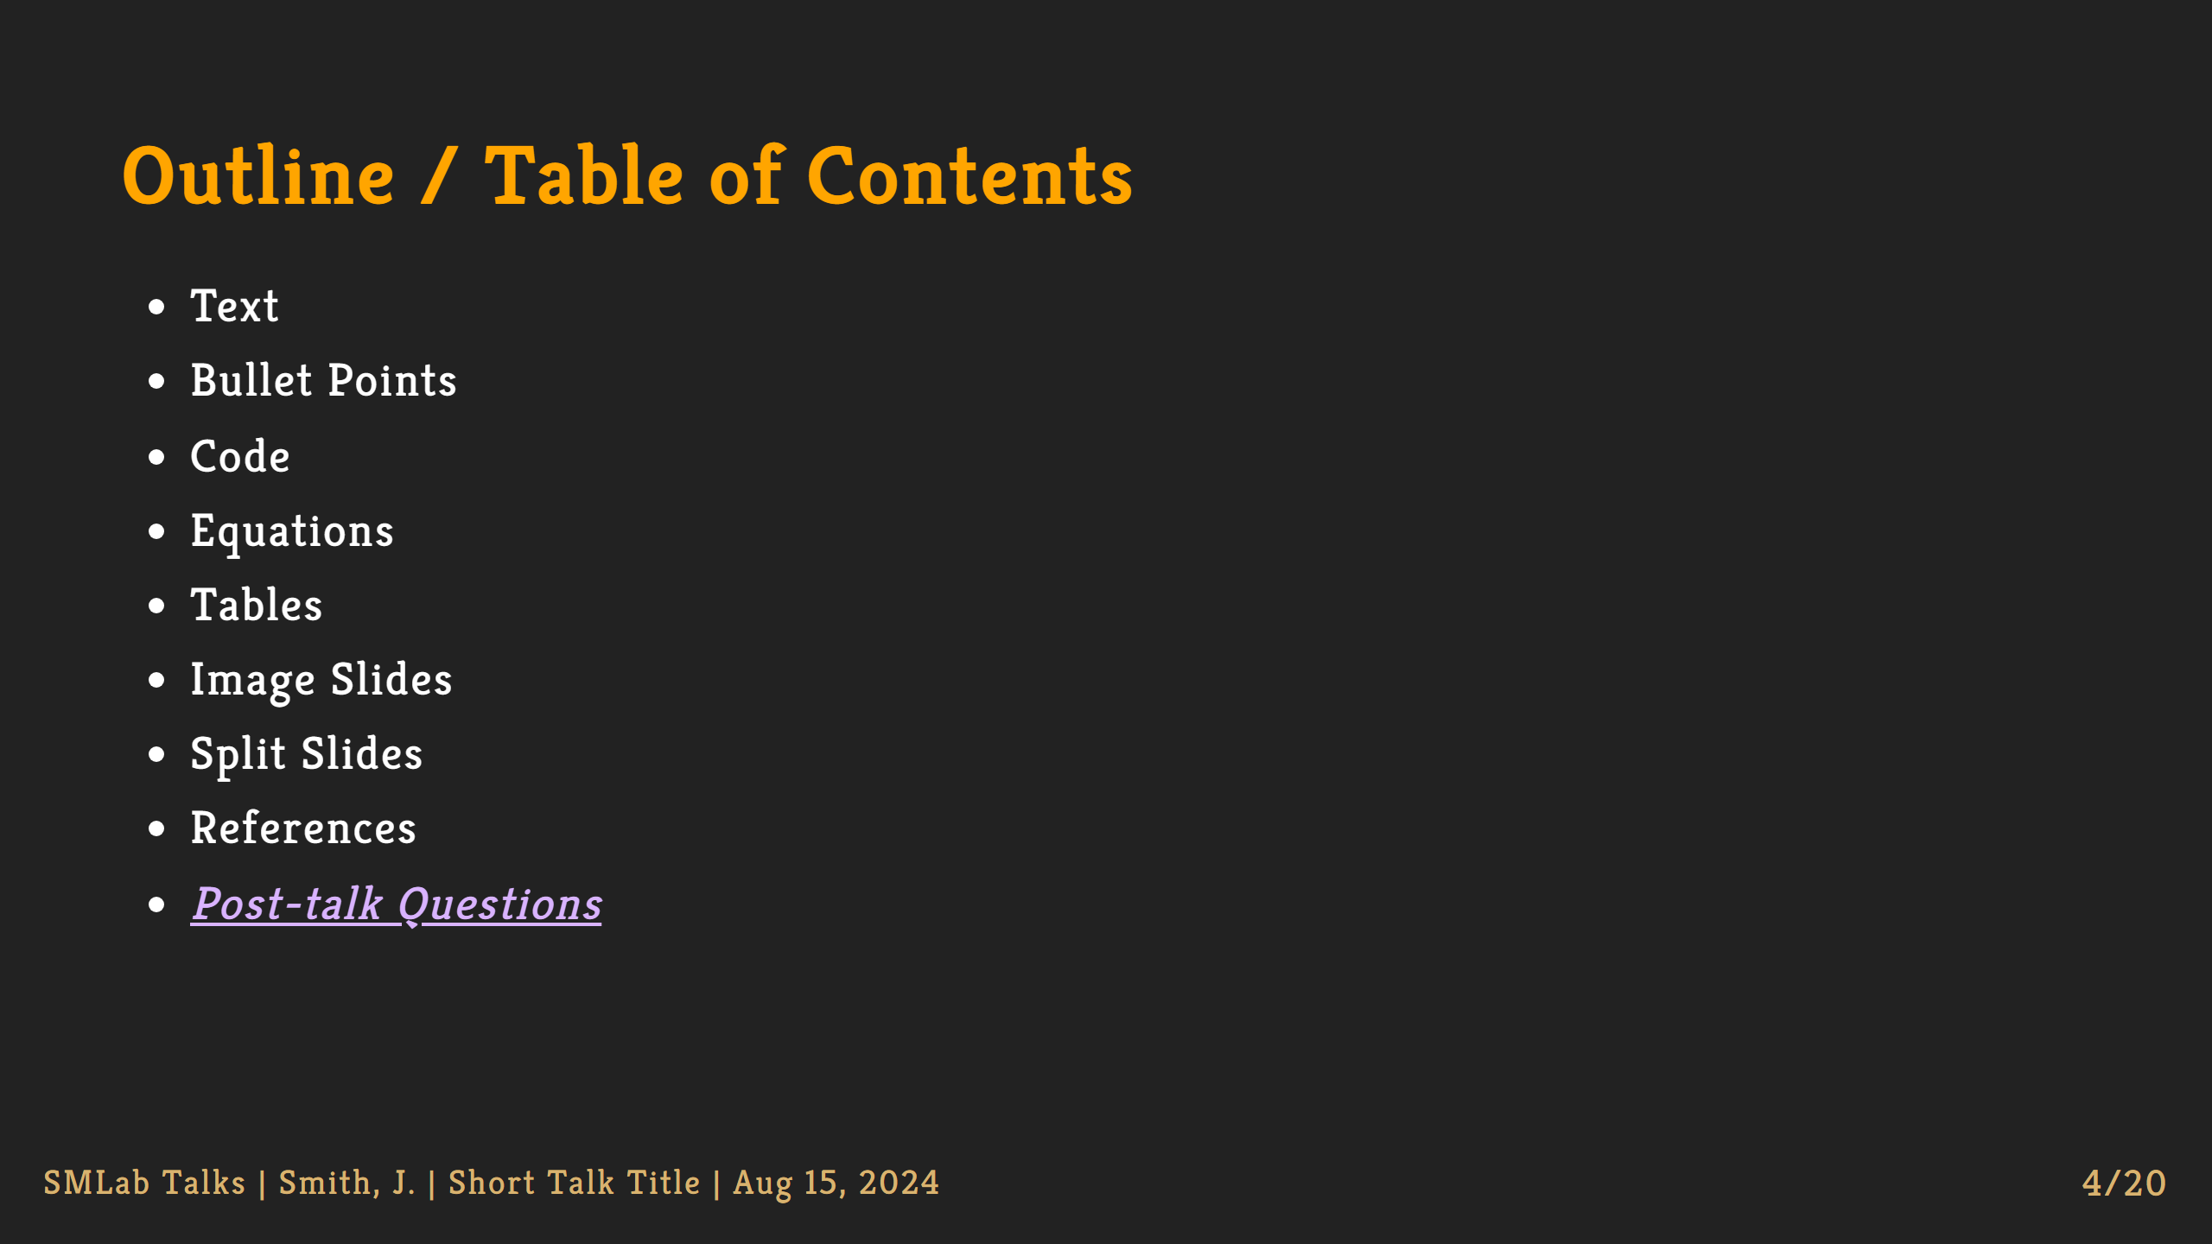
Notes:
NOTE: In VS Code, you can use extensions like "Markdown All in One" to auto-create Table of Contents with links NOTE: This is a example link to other slides

Slide 5
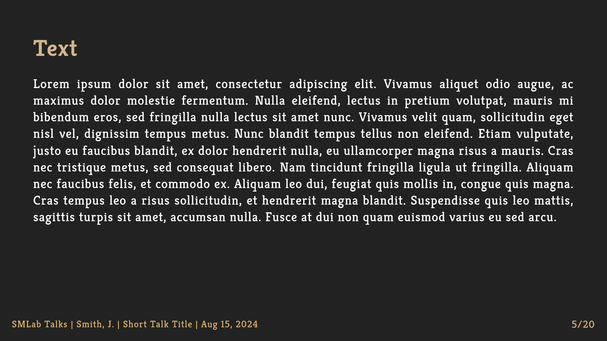

Slide 6
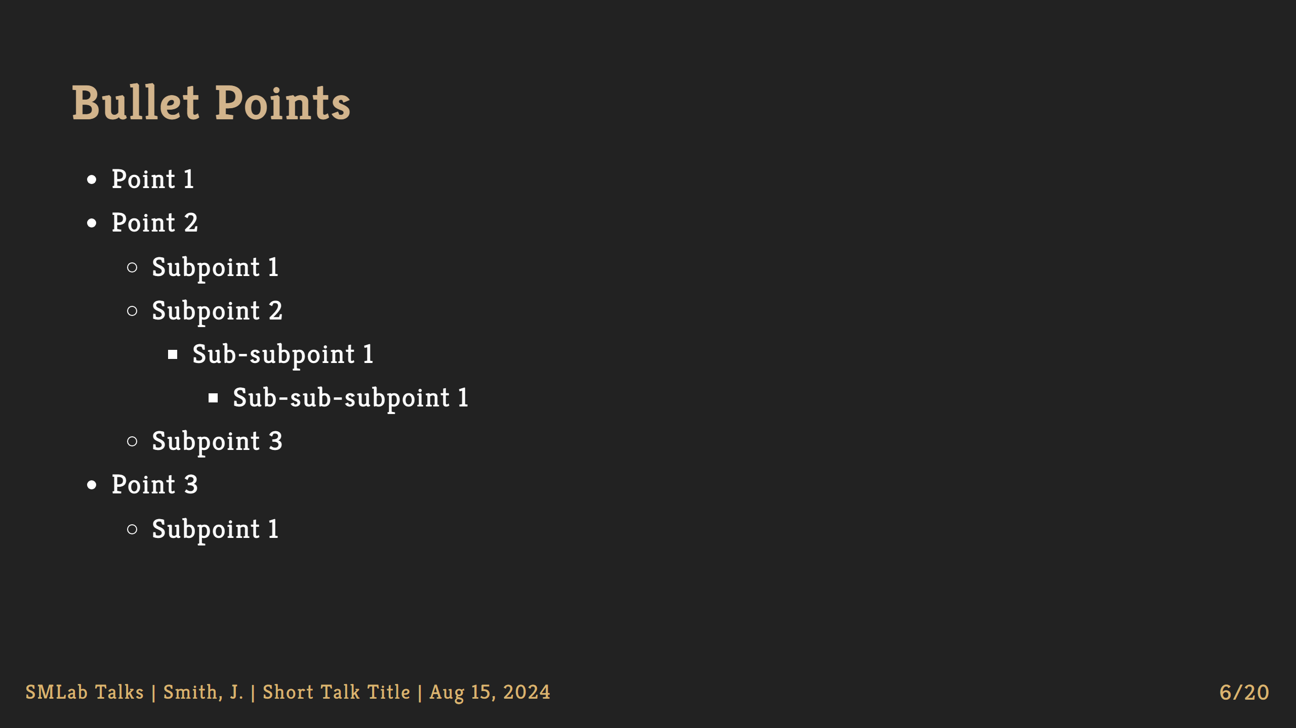

Slide 7
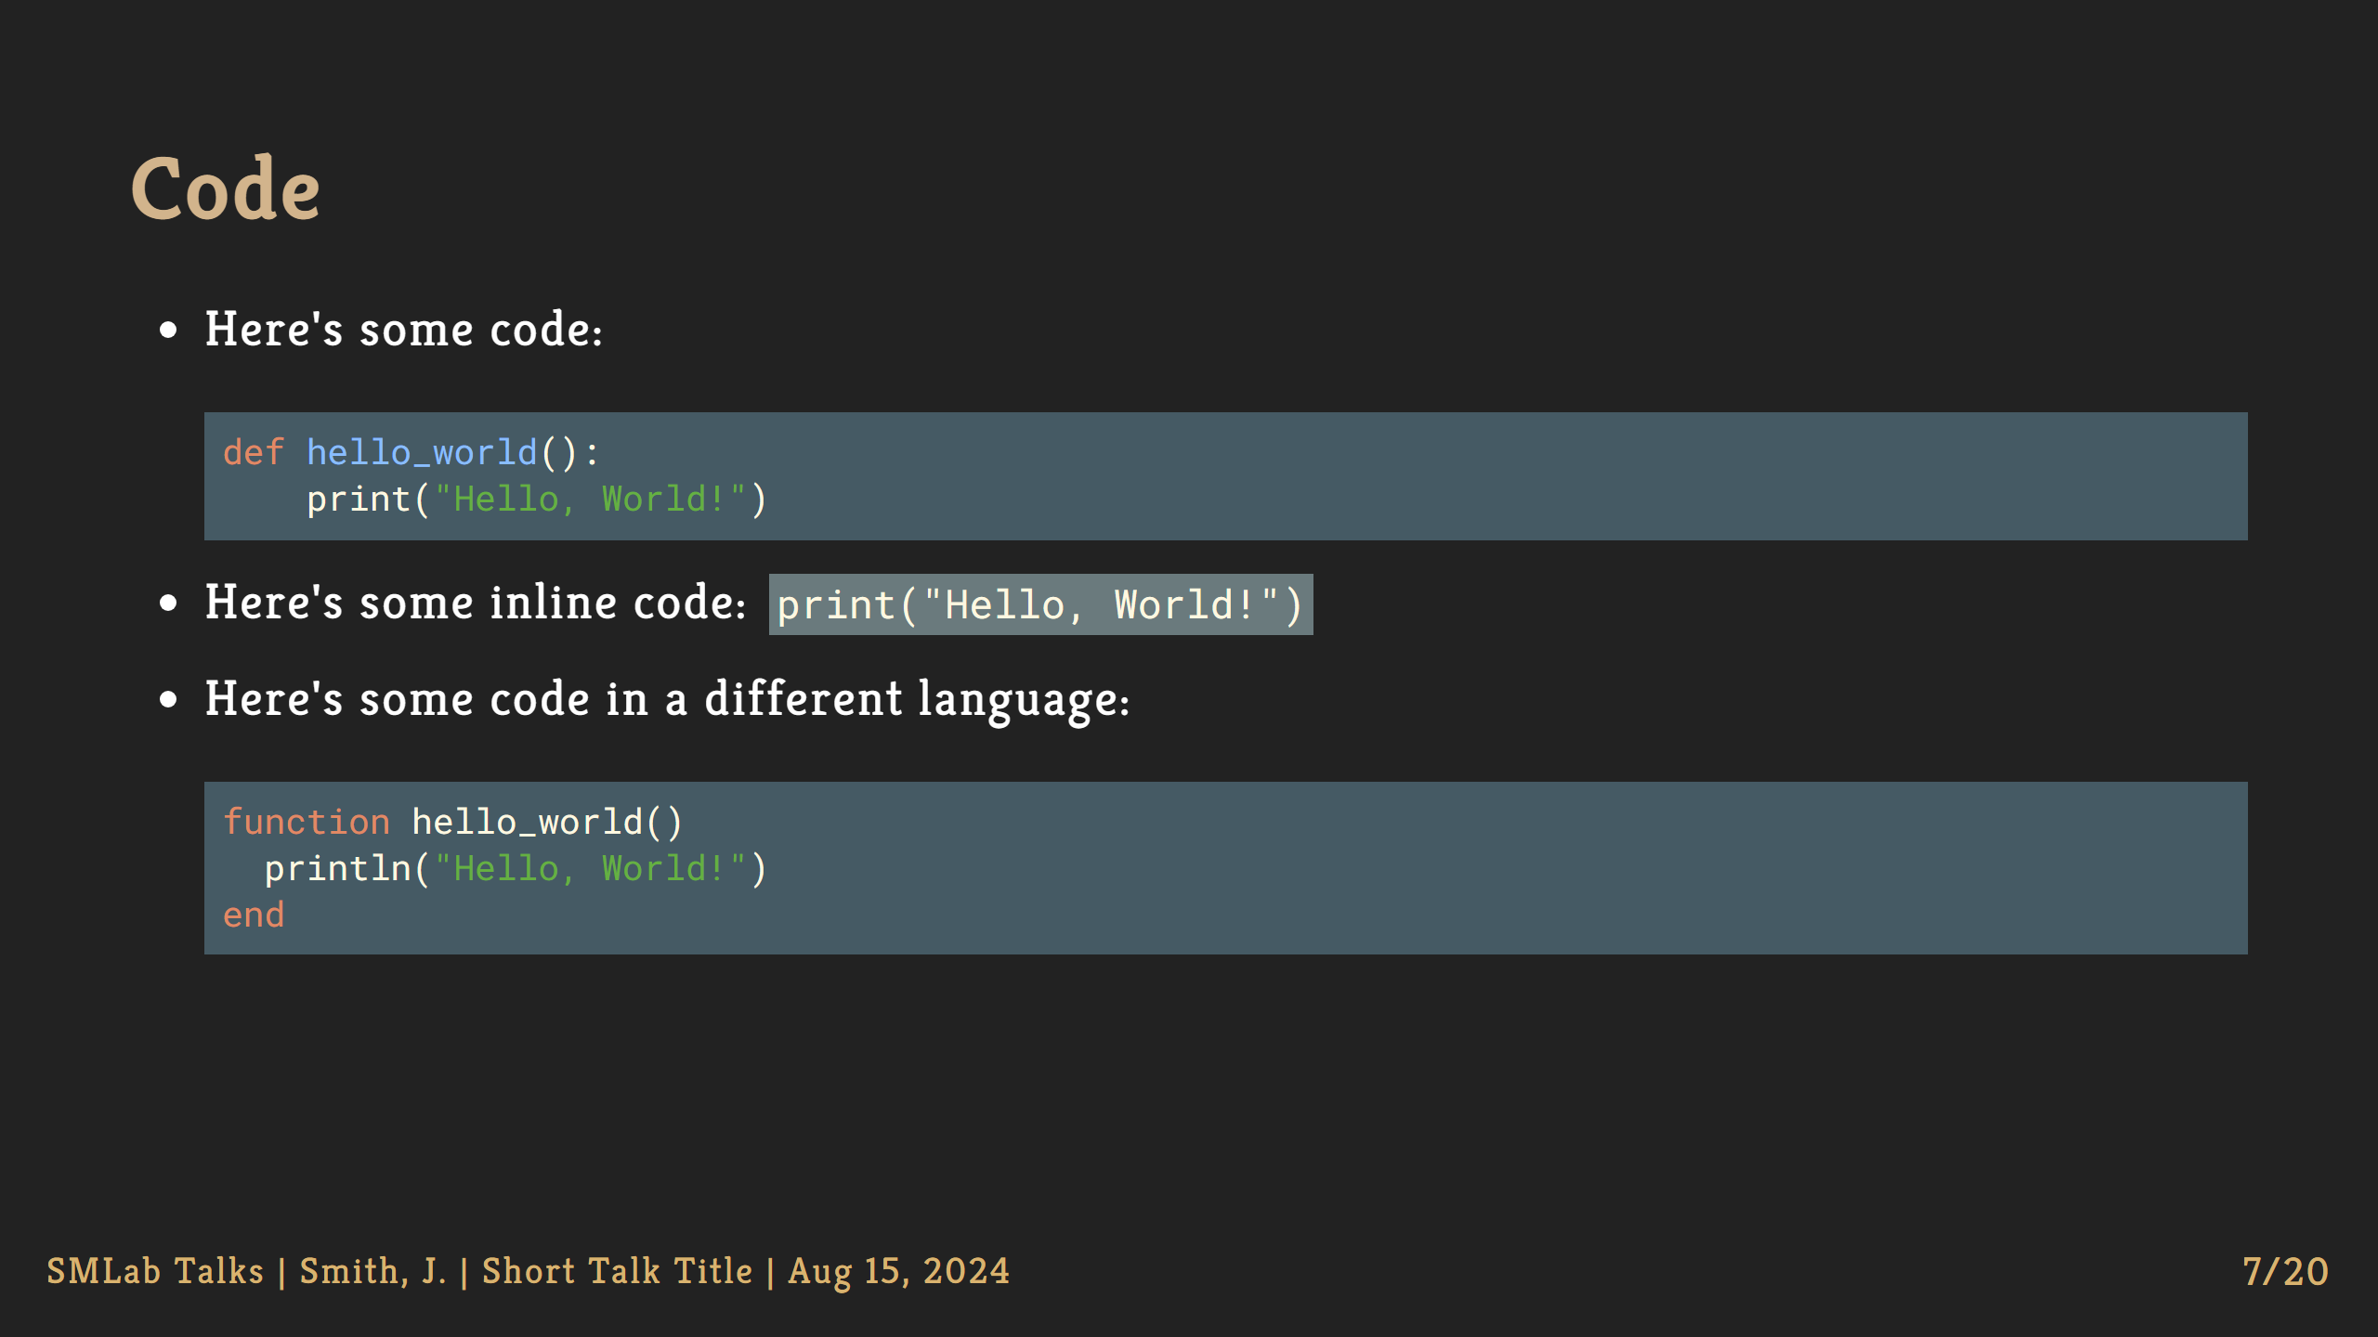

Slide 8
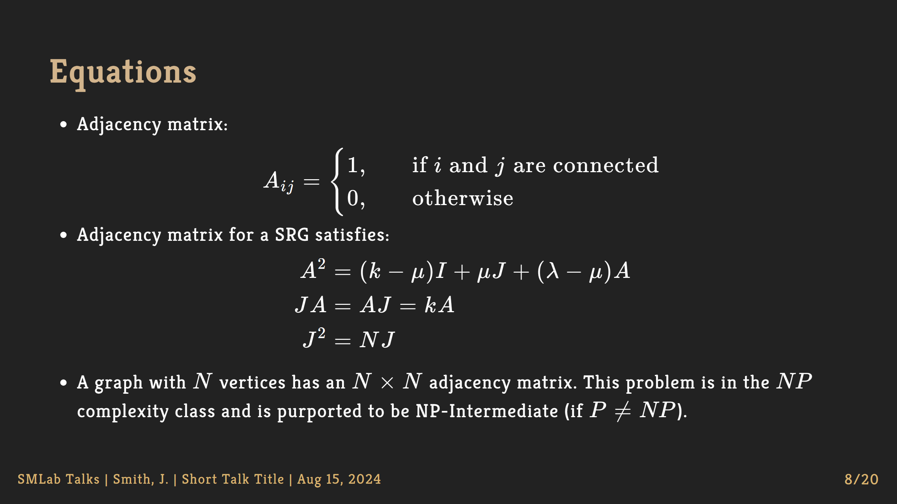

Slide 9
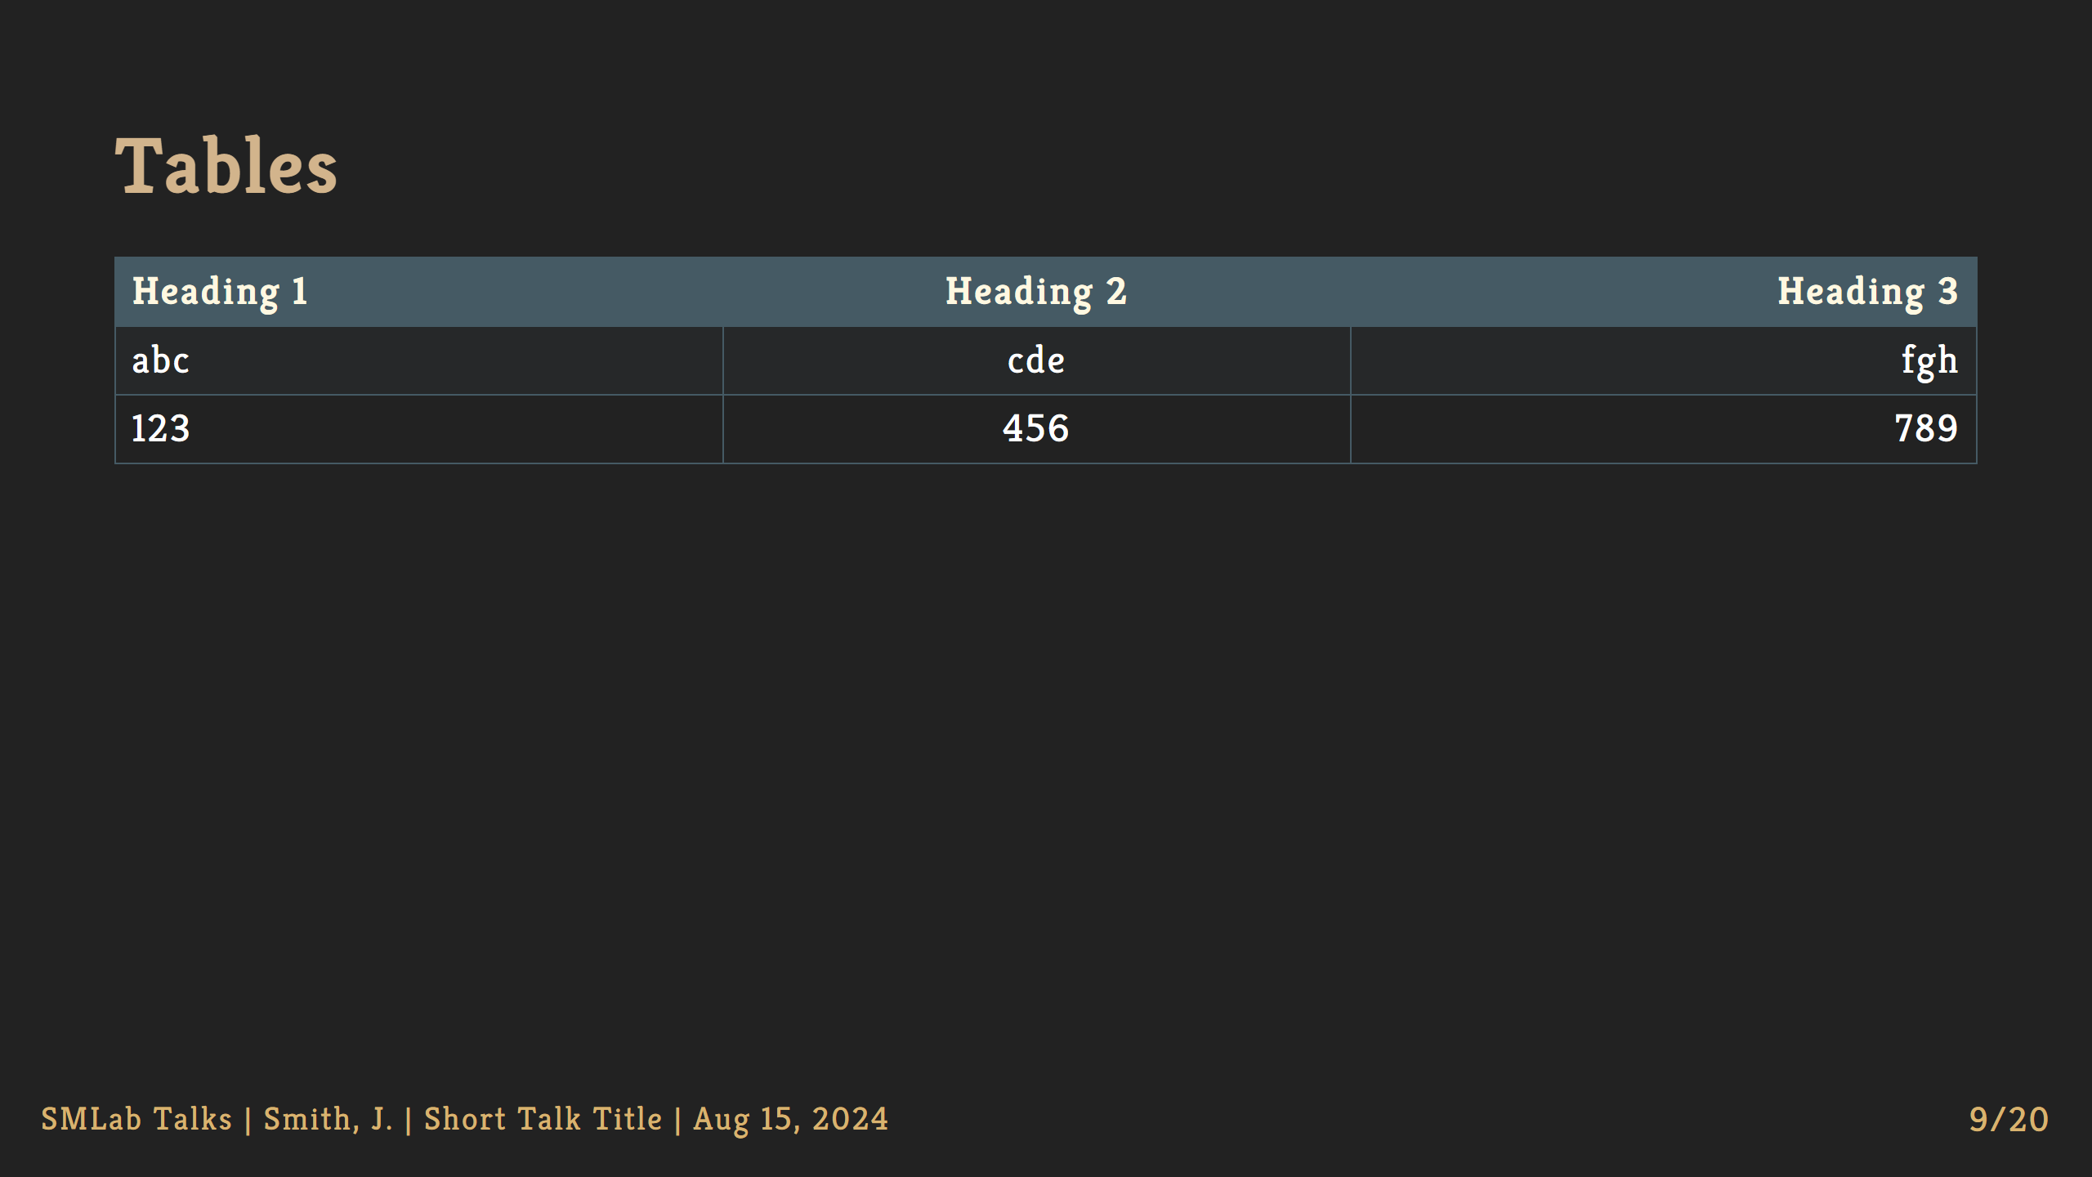

Slide 10
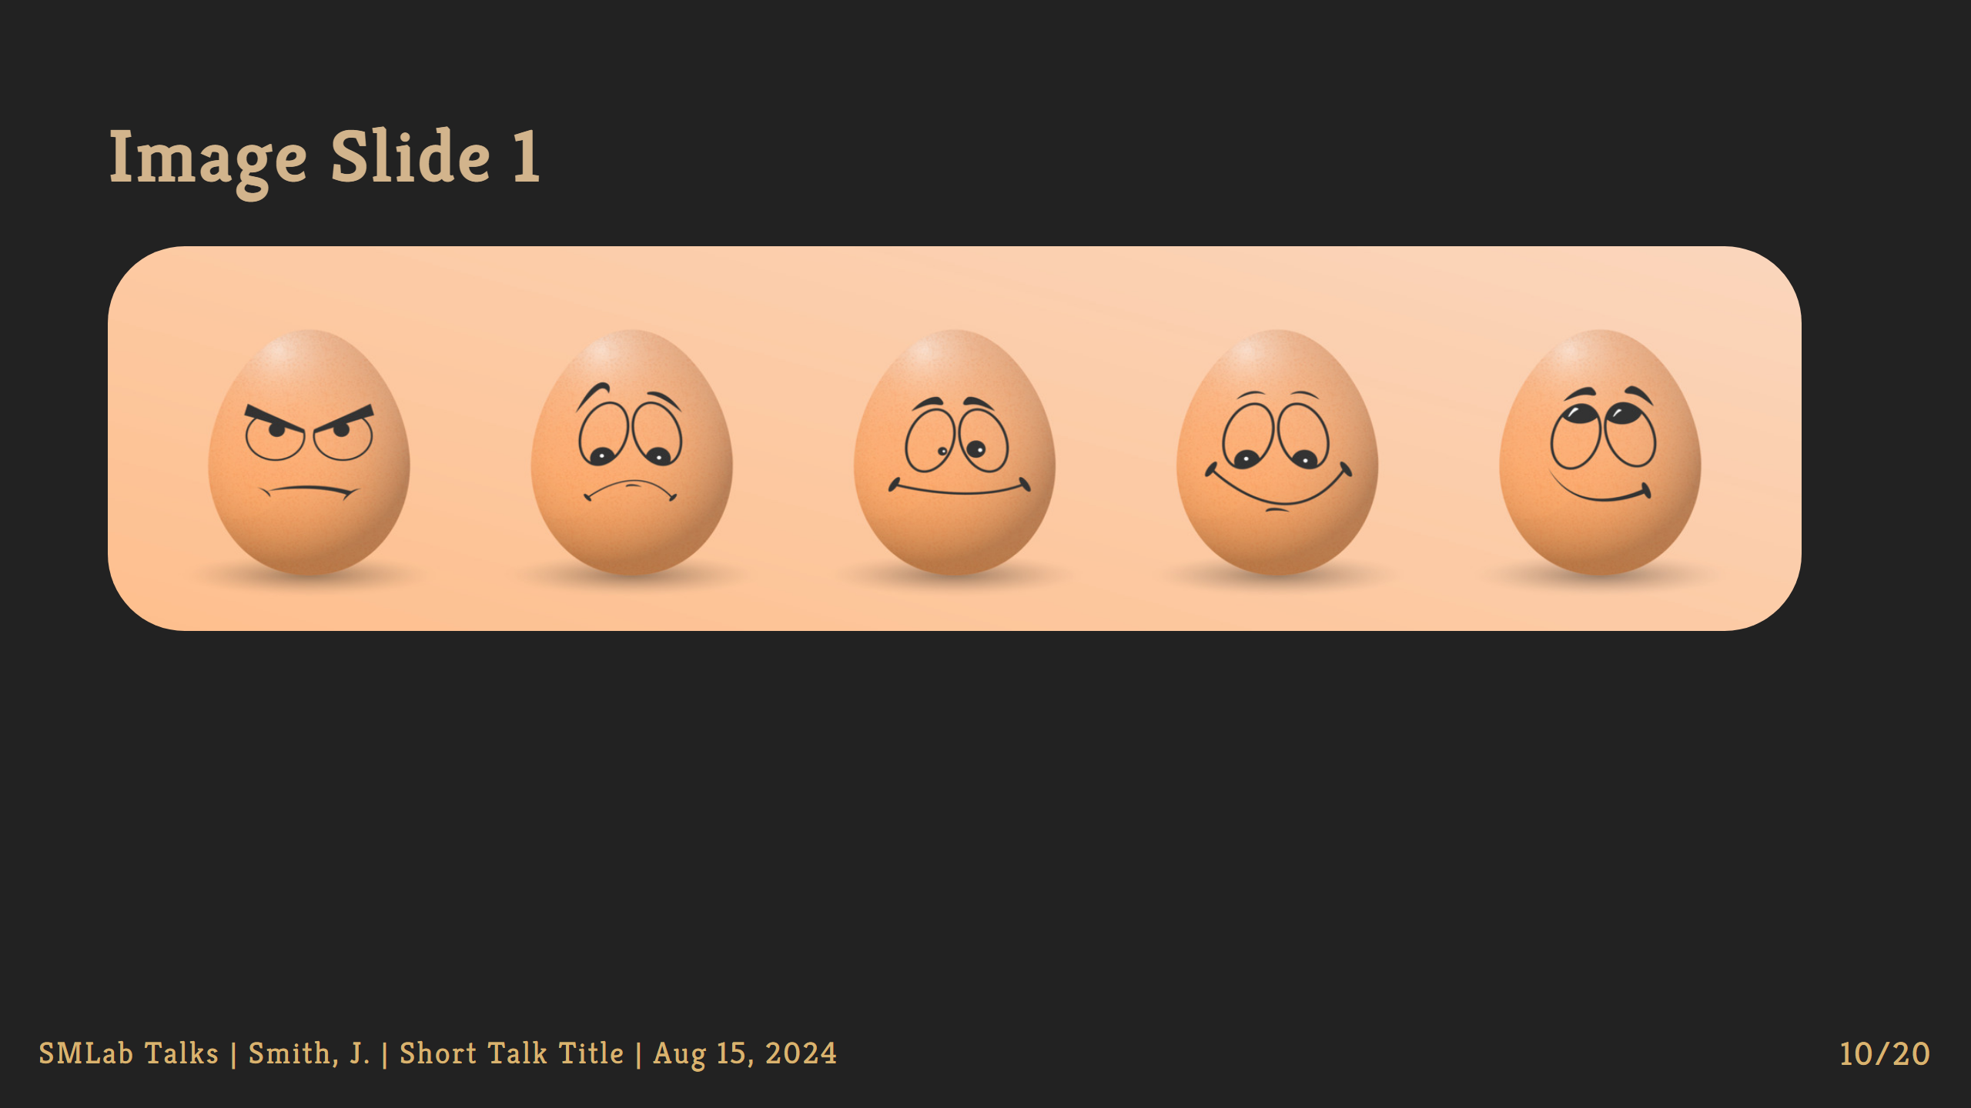
Notes:
NOTE: Setting a background image of a particular width and height

Slide 11

Notes:
NOTE: Another example of image as a background

Slide 12
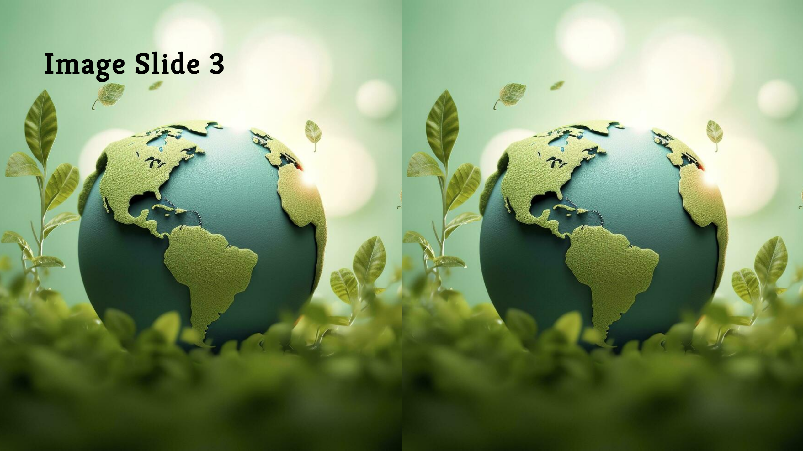
Notes:
NOTE: Another example of image as a background

Slide 13
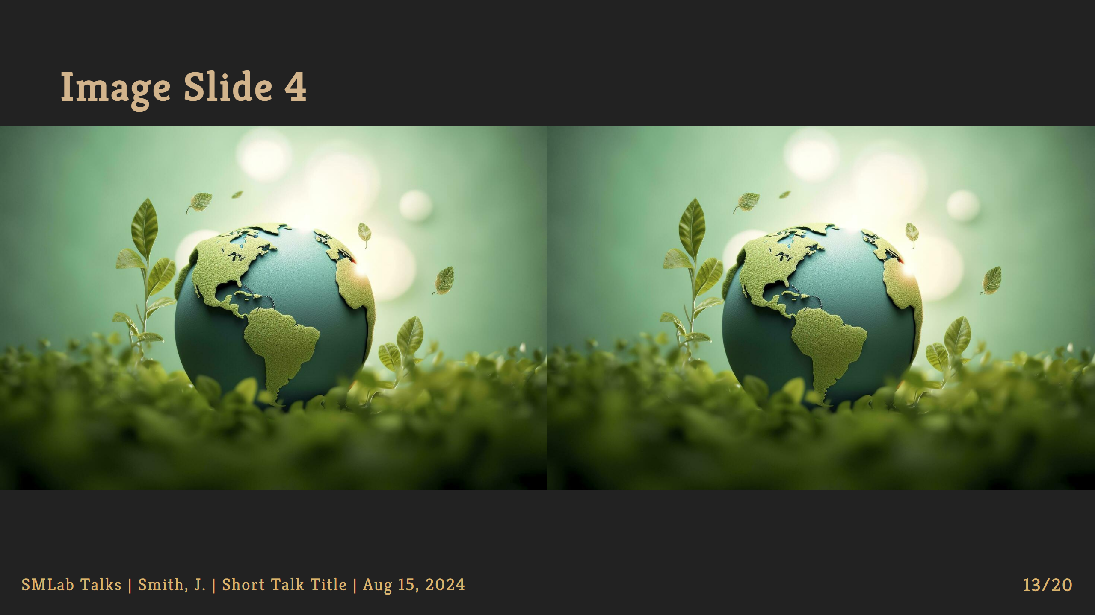
Notes:
NOTE: Another example of image as a background

Slide 14
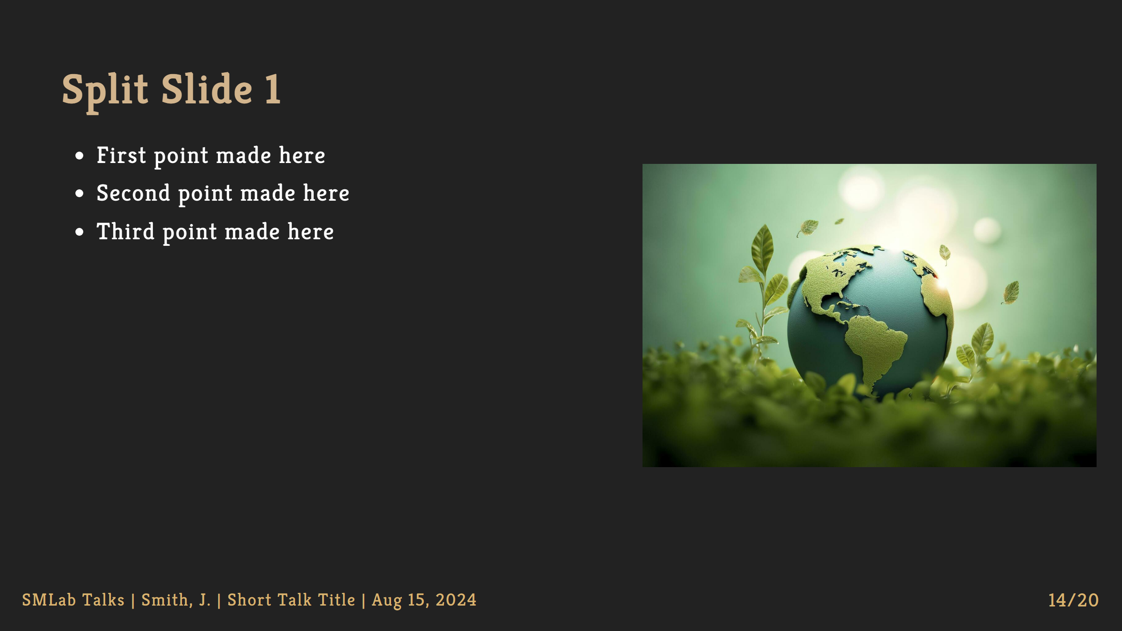

Slide 15
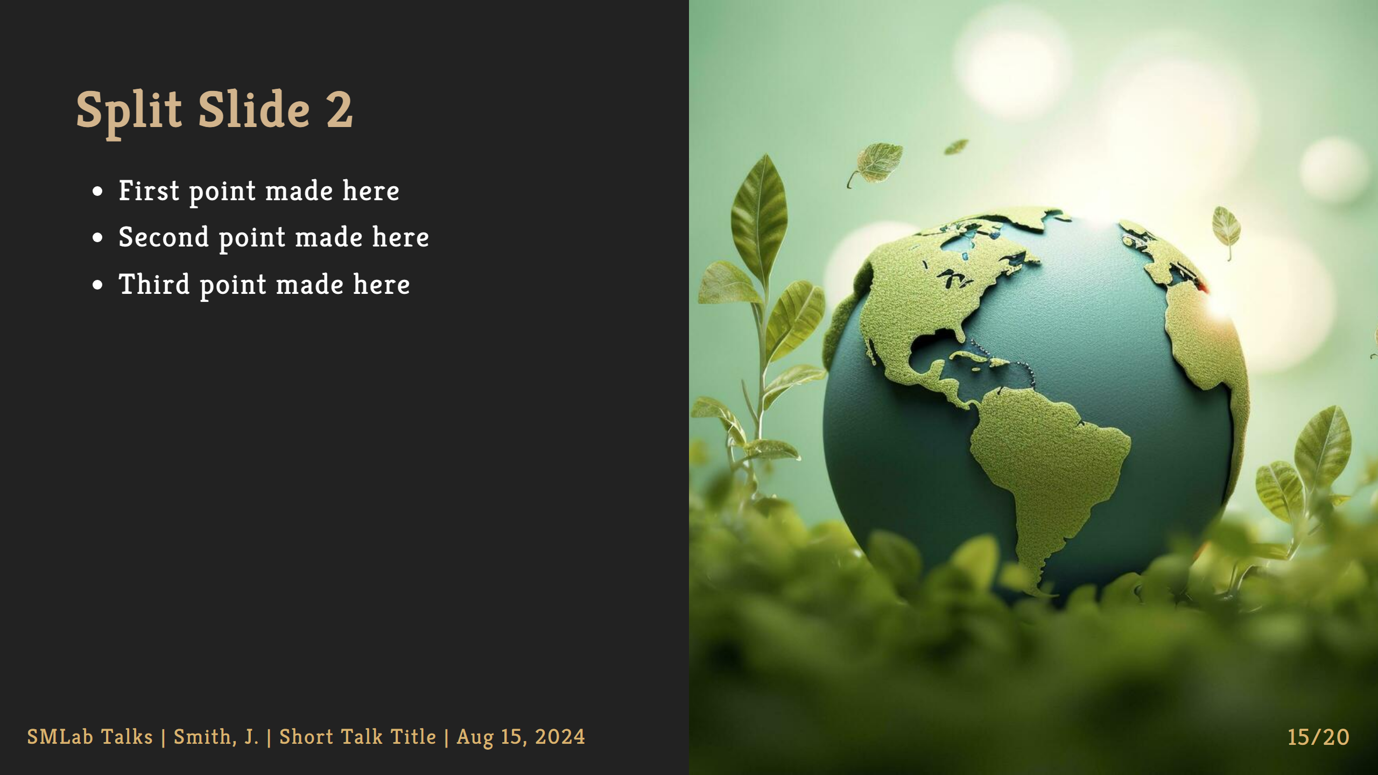

Slide 16
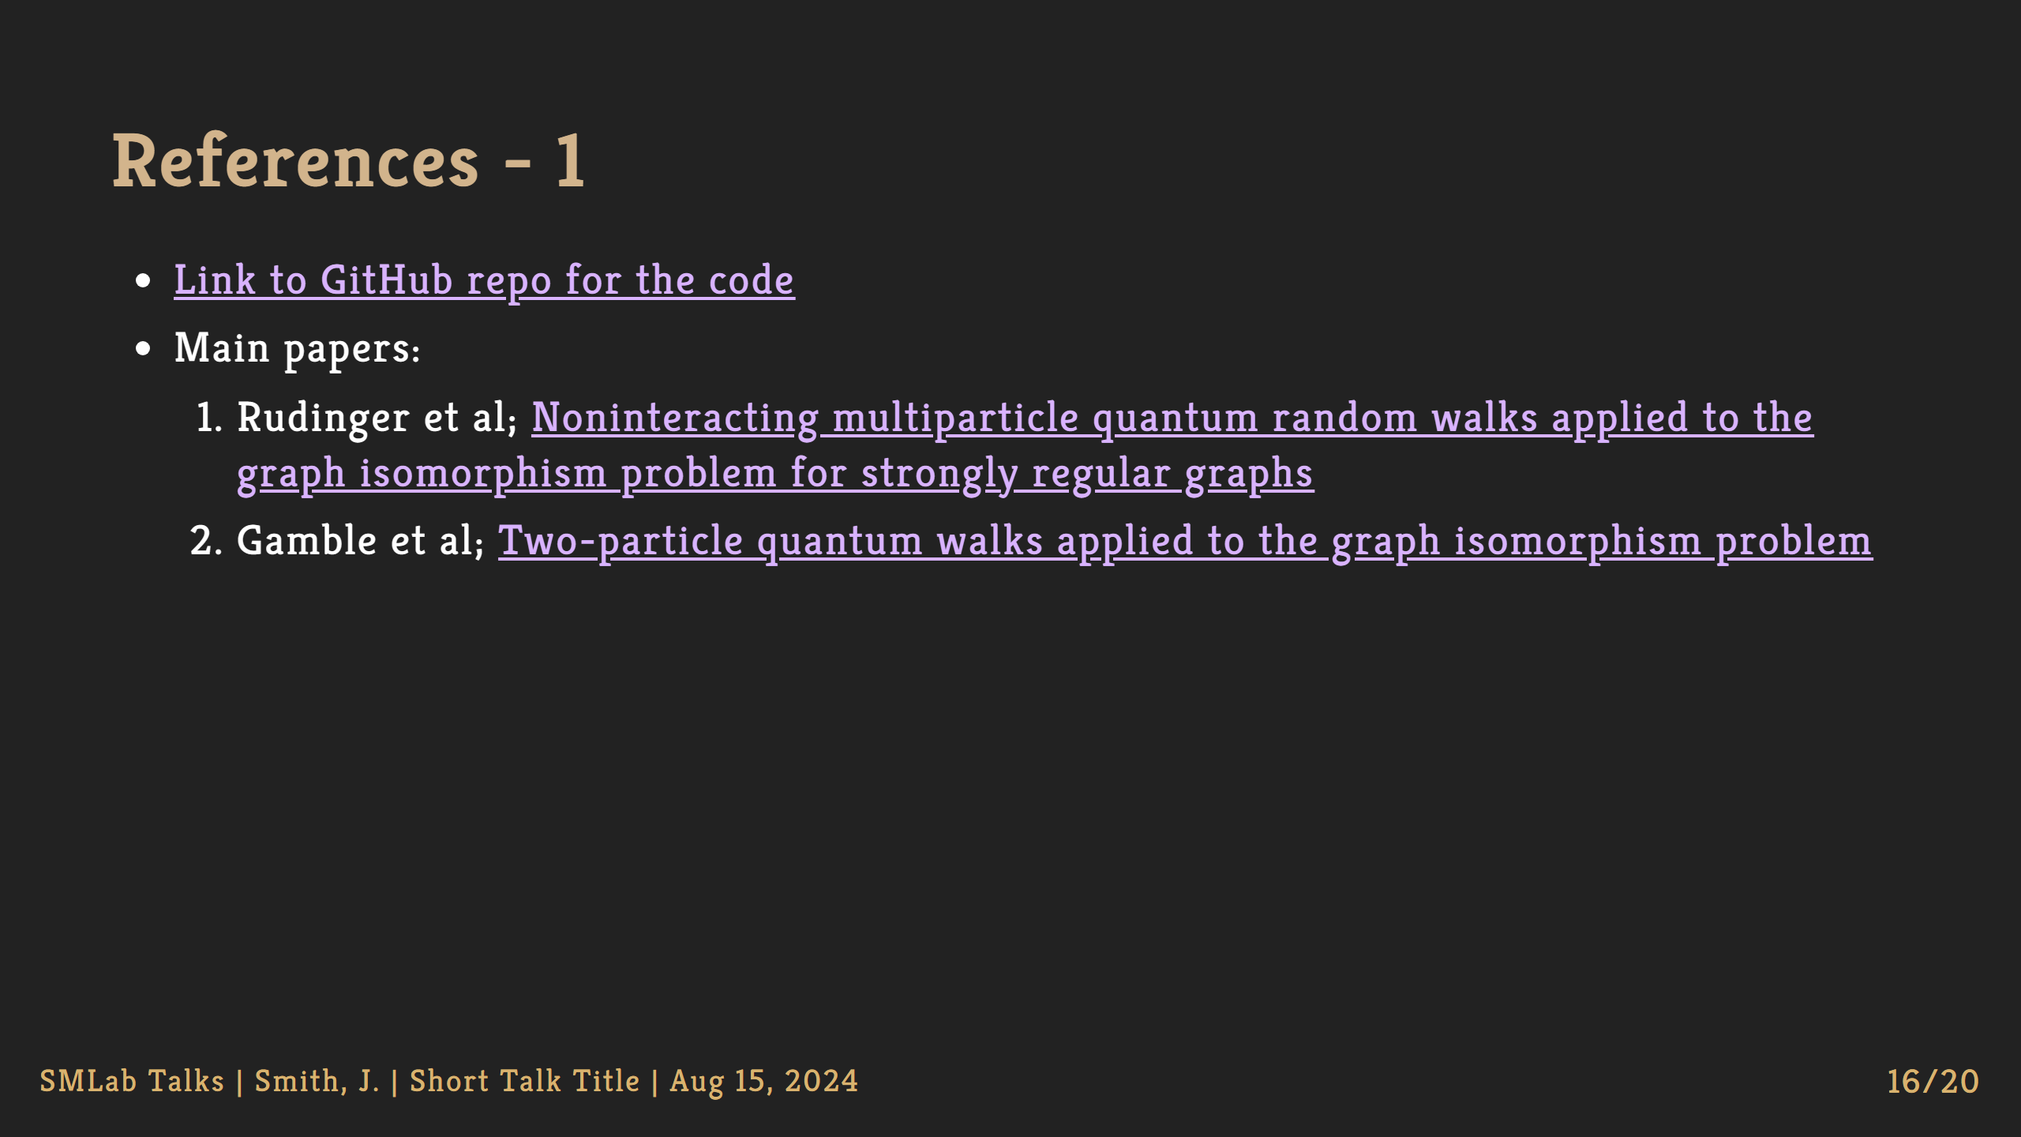

Slide 17
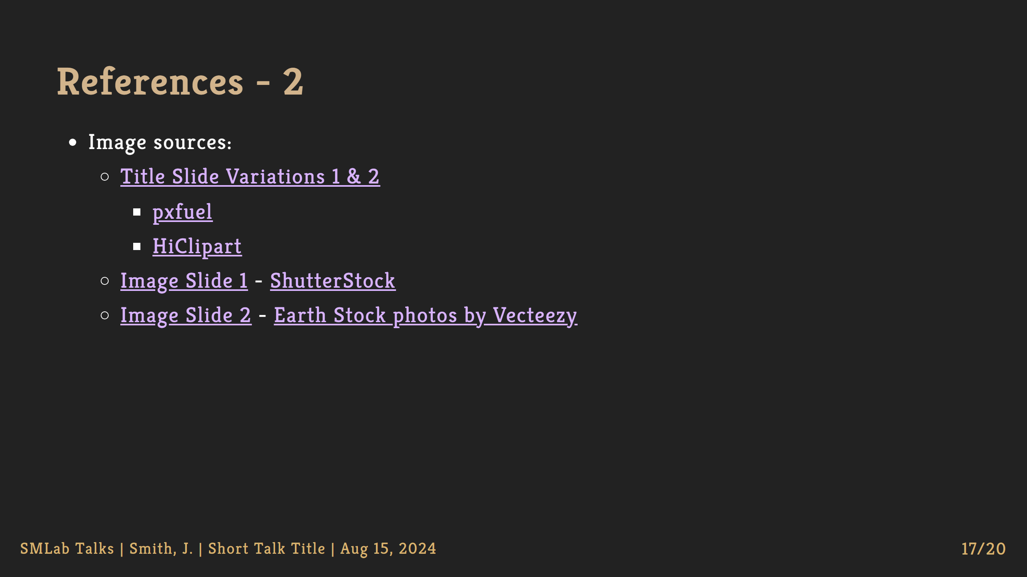

Slide 18


Slide 19

Notes:
NOTE: This is for after the talk, to add some extra details based on feedback if needed

Slide 20

Notes:
NOTE: LEAVE THIS SLIDE AS-IS NOTE: Multiple images added here - one in BG, one in FG Socials

